Slide 1
Layout Managers
Lecture 31

Slide 2
Learning objectives:
After the completion of today’s session you will be able to:
Analyze various types of layout managers in java.
Implement the components on the different layouts.

Slide 3
Java Layout Managers
The LayoutManagers are used to arrange components in a particular manner.
LayoutManager is an interface that is implemented by all the classes of layout managers.
There are following classes that represents the layout managers:
java.awt.FlowLayout
java.awt.BorderLayout
java.awt.GridLayout
java.awt.CardLayout
java.awt.GridBagLayout

Slide 4
1. Flow Layout
The FlowLayout is used to arrange the components in a line, one after another (in a flow).
It is the default layout of applet or panel.

Slide 5
Constructors of Flow Layout class
FlowLayout(): creates a flow layout with centered alignment and a default 5 unit horizontal and vertical gap.
FlowLayout(int align): creates a flow layout with the given alignment and a default 5 unit horizontal and vertical gap.
FlowLayout(int align, int hgap, int vgap): creates a flow layout with the given alignment and the given horizontal and vertical gap.

Slide 6
Alignment in Flow Layout
FlowLayout.LEFT
FlowLayout.CENTER
FlowLayout.RIGHT
FlowLayout.LEADING
FlowLayout.TRAILING

Slide 7
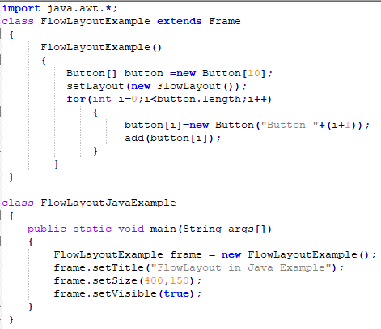
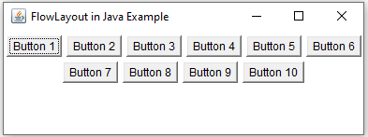
Flow Layout Example
Output

Slide 8
2. BorderLayout
The BorderLayout is used to arrange the components in five regions: north, south, east, west and center.
Each region (area) may contain one component only.
It is the default layout of frame or window.
The BorderLayout provides five constants for each region:
public static final int NORTH
public static final int SOUTH
public static final int EAST
public static final int WEST
public static final int CENTER

Slide 9
Constructors of Border Layout class
BorderLayout( )
BorderLayout(int horz, int vert)

Slide 10
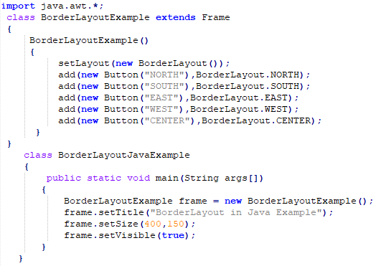
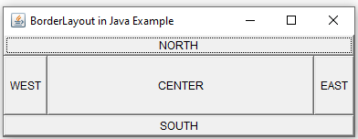
Border Layout Example
Output

Slide 11
3. Grid Layout
The GridLayout is used to arrange the components in rectangular grid.
One component is displayed in each rectangle.

Slide 12
Constructors of Grid Layout class
GridLayout(): creates a grid layout with one column per component in a row.
GridLayout(int rows, int columns): creates a grid layout with the given rows and columns but no gaps between the components.
GridLayout(int rows, int columns, int hgap, int vgap): creates a grid layout with the given rows and columns along with given horizontal and vertical gaps.

Slide 13
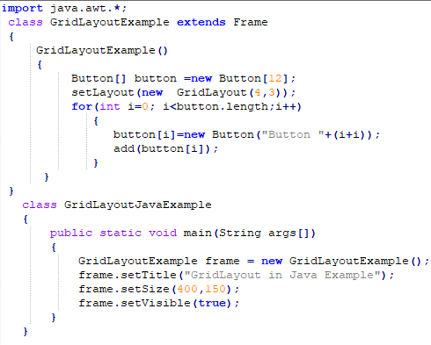
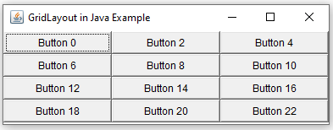
Grid Layout Example
Output

Slide 14
4. GridBag Layout
The Java GridBagLayout class is used to align components vertically, horizontally or along their baseline.
The components may not be of same size.
Each GridBagLayout object maintains a dynamic, rectangular grid of cells.
Each component occupies one or more cells known as its display area.
Each component associates an instance of GridBagConstraints.
With the help of constraints object we arrange component's display area on the grid.
The GridBagLayout manages each component's minimum and preferred sizes in order to determine component's size.

Slide 15
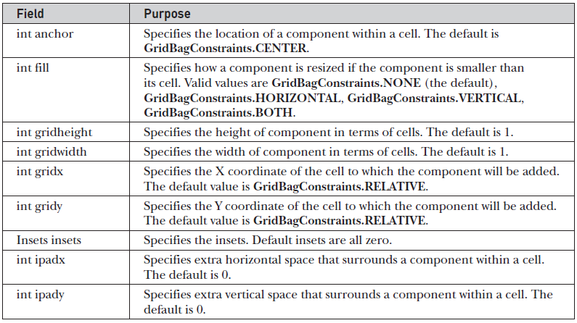
GridBag Layout Constraint fields

Slide 16
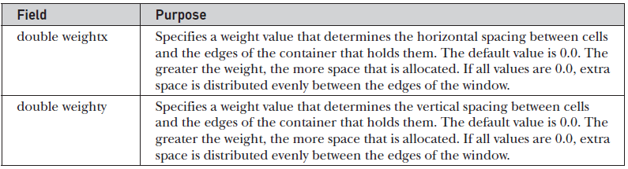
GridBag Layout Constraint fields

Slide 17
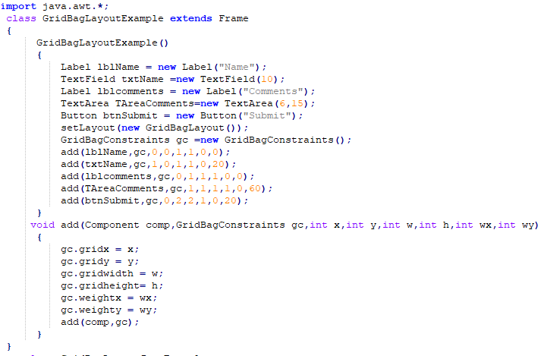
Grid Layout Example

Slide 18
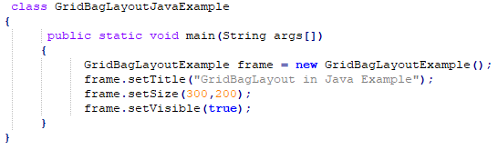
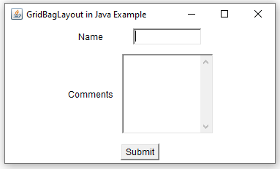
Grid Layout Example
Output

Slide 19
5. Card Layout
The CardLayout class manages the components in such a manner that only one component is visible at a time.
It treats each component as a card that is why it is known as CardLayout.

Slide 20
Constructors of Card Layout class
CardLayout(): creates a card layout with zero horizontal and vertical gap.
CardLayout(int hgap, int vgap): creates a card layout with the given horizontal and vertical gap.

Slide 21
Commonly used methods in Card layout
public void next(Container parent): is used to flip to the next card of the given container.
public void previous(Container parent): is used to flip to the previous card of the given container.
public void first(Container parent): is used to flip to the first card of the given container.
public void last(Container parent): is used to flip to the last card of the given container.
public void show(Container parent, String name): is used to flip to the specified card with the given name.

Slide 22
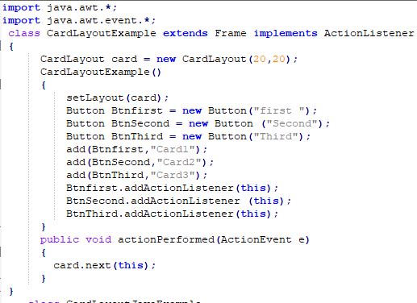
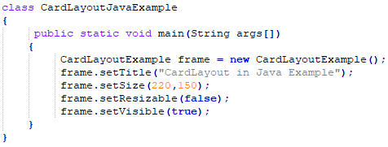
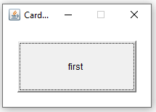
Card Layout Example
Output

Slide 23
References
https://ecomputernotes.com/java/awt-and-applets/

Slide 24
Thanks

